Slide 1
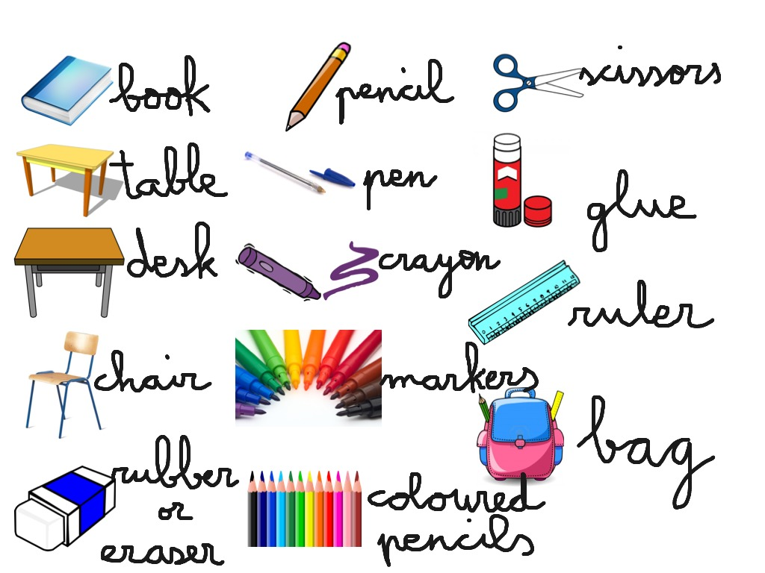

Slide 3
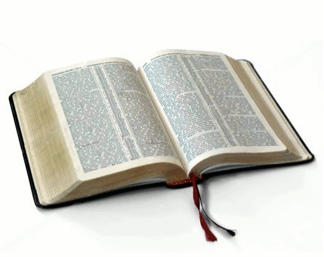
a book

Slide 4
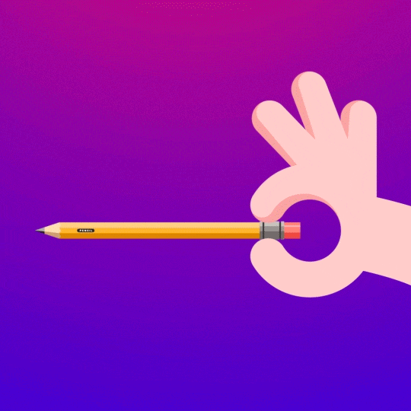
a pencil

Slide 5
an eraser

Slide 6
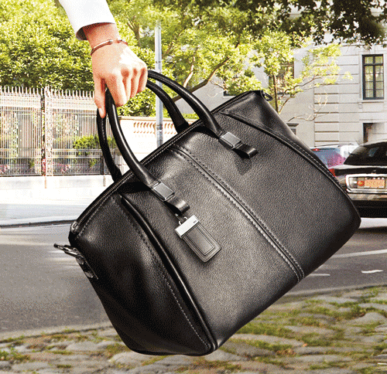
a bag

Slide 7
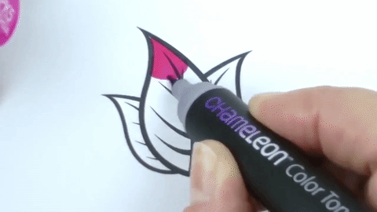
a marker

Slide 8
a ruler

Slide 9
1
2
3
a book
an eraser
a pencil
4
5
6
a bag
a marker
a ruler

Slide 10
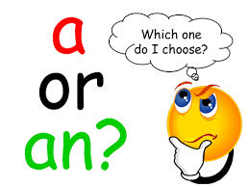
How to use a or an?

Slide 12
(a/an)ant

Slide 13
(a/an)bird

Slide 14
(a/an)cat

Slide 15
(a/an)dog

Slide 16
(a/an)elephant

Slide 17
(a/an)fish

Slide 18
(a/an)gorilla

Slide 19
(a/an)horse

Slide 20
(a/an)iguana

Slide 21
(a/an)jelly fish

Slide 22
(a/an)koala

Slide 23
(a/an)lion

Slide 24
(a/an)mouse

Slide 25
(a/an) nightingale

Slide 26
(a/an)octopus

Slide 27
(a/an)penguin

Slide 28
(a/an)queen

Slide 29
(a/an)rabbit

Slide 30
(a/an)snake

Slide 31
(a/an)turtle

Slide 32
(a/an) Uakari

Slide 33
(a/an)vulture

Slide 34
(a/an)whale

Slide 35
(a/an)zebra

Slide 36
What’s this?
What’s that?

Slide 38
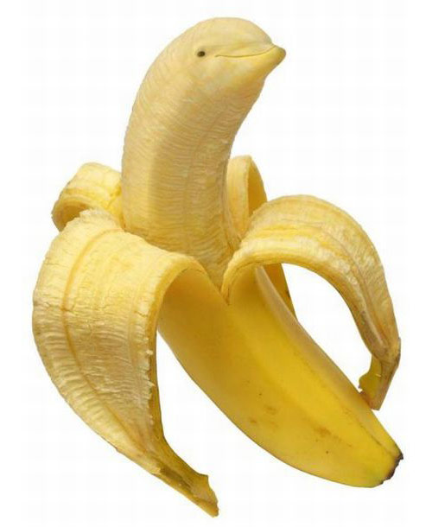
It’s a banana.
What’s this?

Slide 39
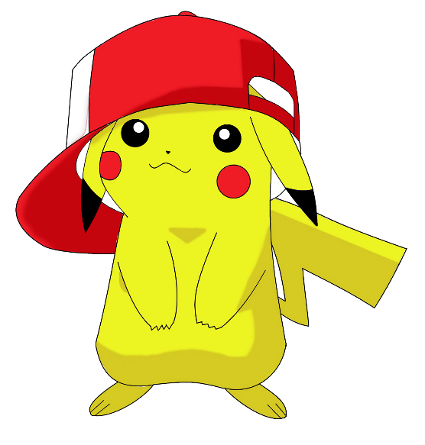
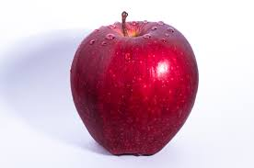
It’s an apple.
What’s that?

Slide 40
It’s a watermelon.
What’s this?

Slide 41
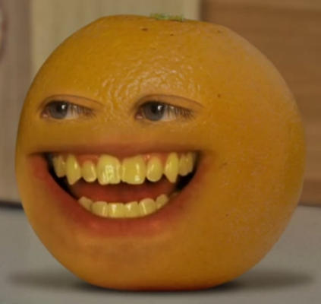
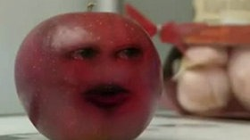
It’s an orange.
What’s that?

Slide 42
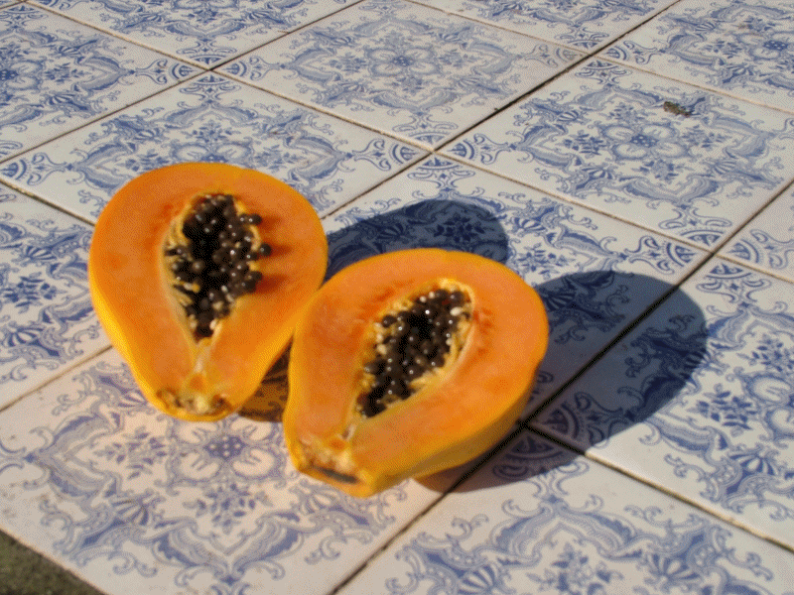
It’s a papaya.
What’s this?

Slide 43
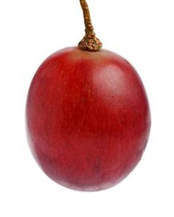
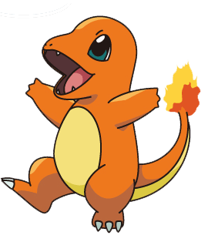
It’s a grape.
What’s that?

Slide 44
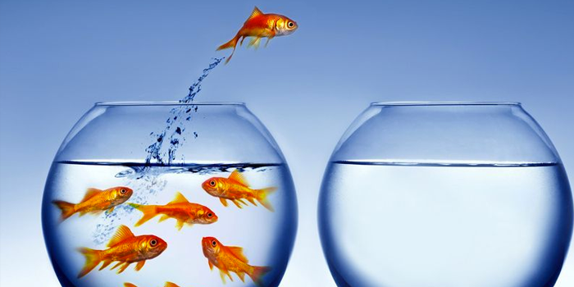
Challenge Time!
This
That

Slide 45
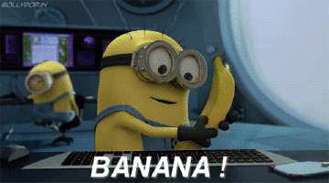
____ is a banana.

Slide 46
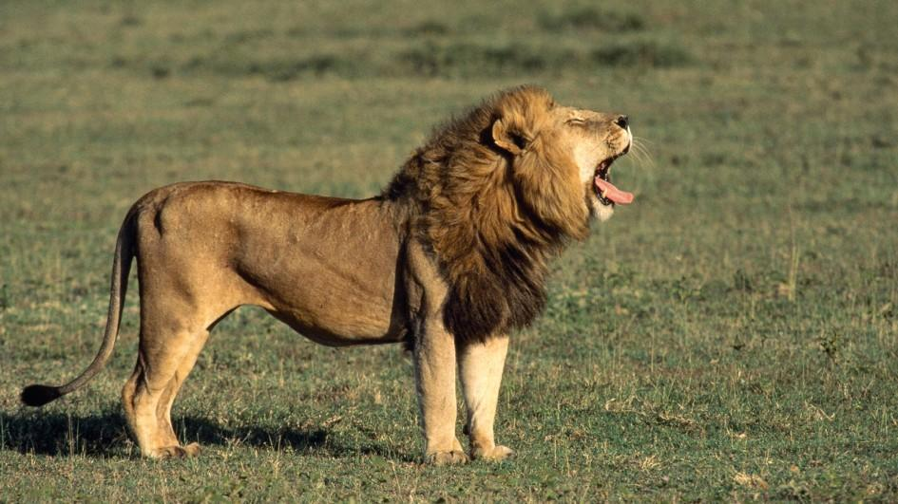
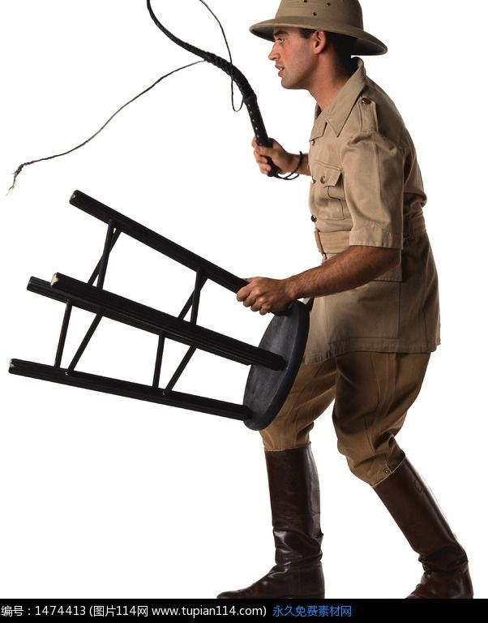
____ is a lion.

Slide 47
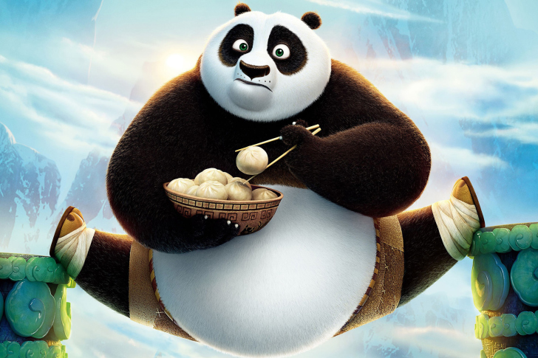
____ is a panda.

Slide 48
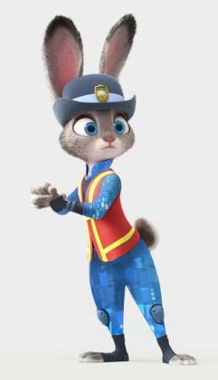
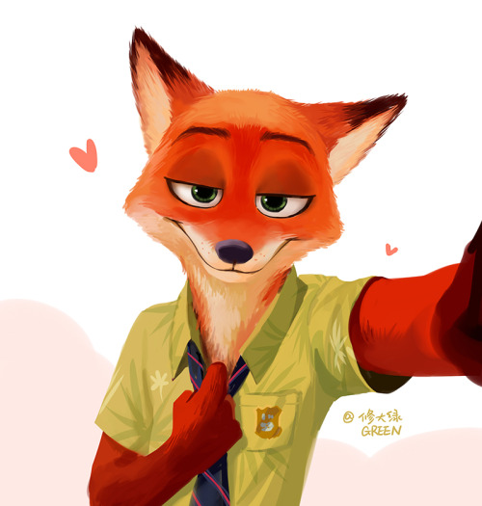
____ is a fox.

